Slide 1
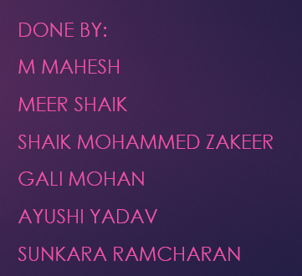
CUSTOMER PERSONALITY ANALYSIS
☺

Slide 2

Understanding the business problem:
The business problem is to segment customers based on their personalities (demographic) and the amount they spend on products (behavioral). This will help the company to gain a better understanding of the customers' personalities and habits.

Slide 3
ABOUT THE DATASET
CUSTOMER PERSONALITY FEATURES
PEOPLE:
Year Birth
Education.
Marital Status.
Income.
Kidhome Teenhome.
Dt _ Customer, Recency and Complain.
PRODUCT:
MntWines.
MntFruits.
MntMeat Products.
MntFishProducts.
MntSweetProducts.
MntGold Products.
PROMOTION:
Num Deals Purchases.
AcceptedCmp1.
AcceptedCmp2.
AcceptedCmp3.
AcceptedCmp4.
AcceptedCmp5.
Response Place.
PLACE:
Num Web Purchases.
Num Catagorical Purchases.
Num Store Purchases.
Num Web Visits.

Slide 4
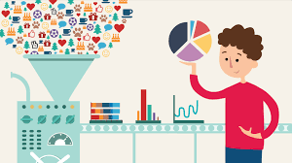
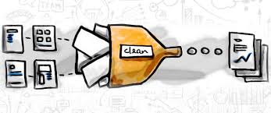
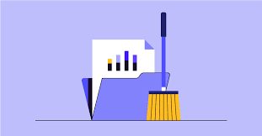
COMPREHEND THE DATA
Data contains 2240 rows and 29 columns.
It has 1 float, 3 objects, and 25 int columns.
There are 24 missing values(NULL) in the Income feature.
There are no duplicate values within the data.
Z_CostContact and Z_Revenue is having only 1 unique value so we need to drop these columns because it consists of Zero Variance.
ID column is also dropped because value seems to be unique identifier which may not provide meaningful info for analysis

Slide 5
PRIMARY GOALS
How to deal with Null values

Slide 6
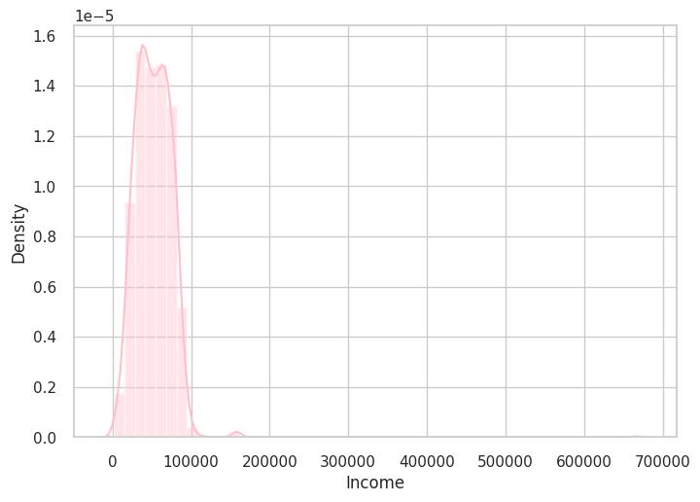
KNOWING DATA SKEWNESS
Since there are some missing data in Income, we are going to use “Mean” or “Median” to fill the gap based on its skewed nature.
For distributions that have outliers or are skewed, the median is often the preferred measure of central tendency because the median is more resistant to outliers than the mean.
Hence, the data is left skewed we will replace the missing values with “Median”.

Slide 7
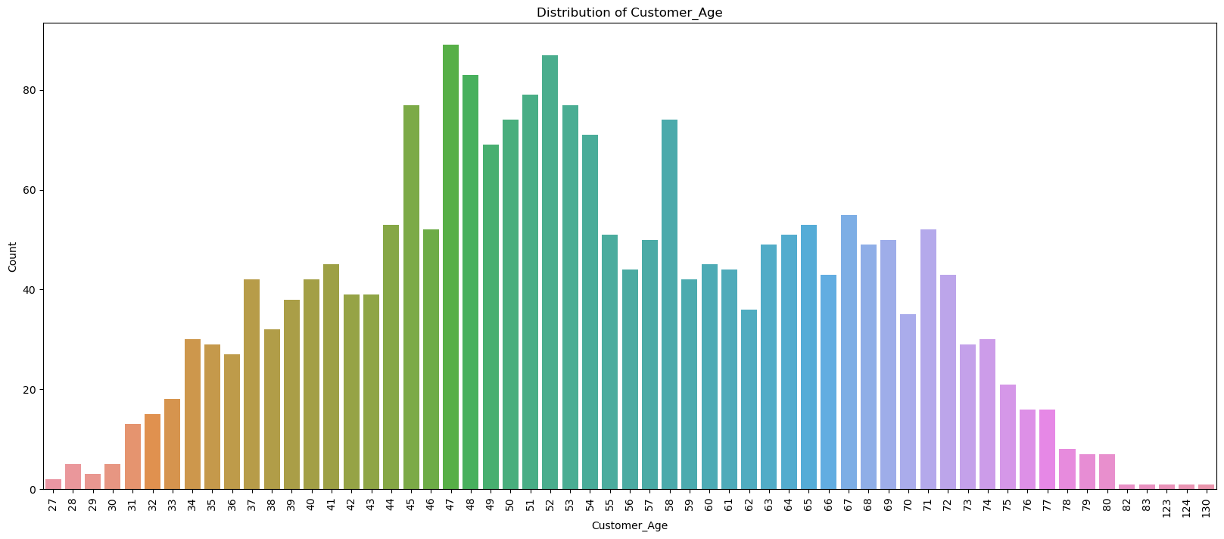
UNIVARIANT ANALYSIS – “Peoples features”
UNIVARIANT ANALYSIS:
PEOPLE:
Year_Birth: - Instead of Year_Birth let’s have an age column that is easy to understand the customer’s age. This is the visualization of Age.

Slide 8
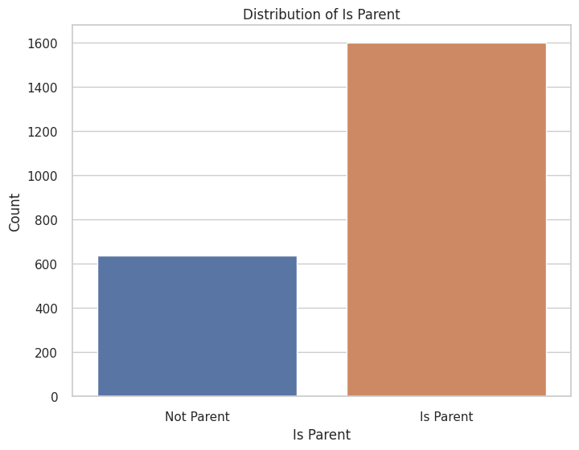
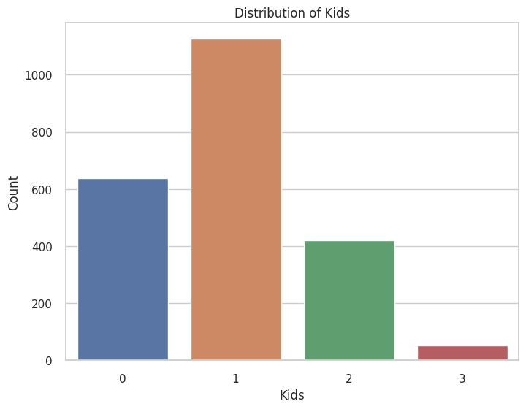
Peoples features
Kid Home & Teen Home: - These are grouped and made into 2 column as “Kids & Is parent”.

Slide 9
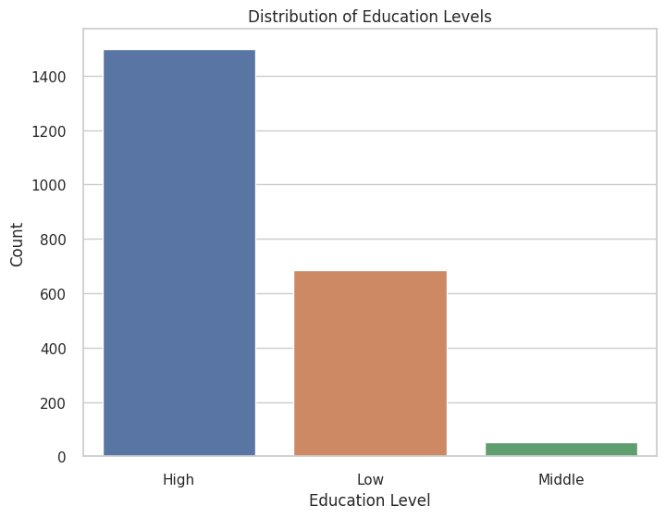
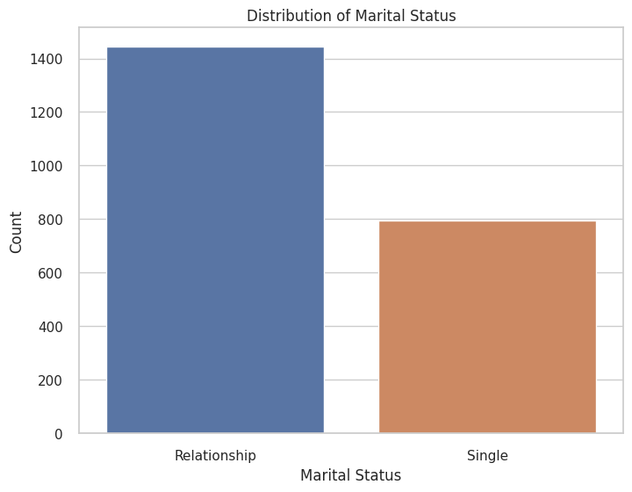
Peoples features
Education: - Education consists of Categorical data like Graduation, Ph.D., Master, 2n cycle, and Basic. we can group them into 3 categories like High, Medium and Low
Marital_Status: - Similarly, let’s convert the categorical data of Marital_Status to Single or Relationship.
Dt_Customer: - Converting the Dt_Customer into datetime format “Customer_For”. Like when the customer visited lastly(Duration).

Slide 10
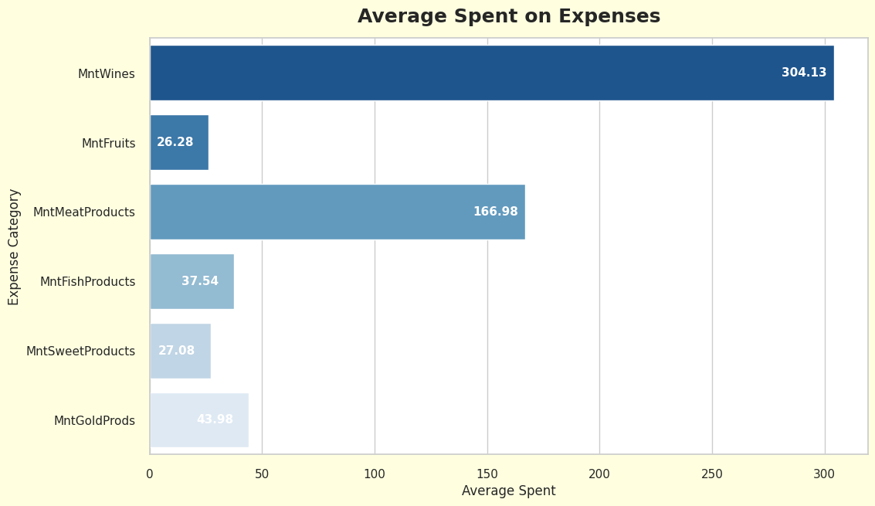
SUMMARY ON PRODUCTS, PROMOTION & PLACE - “PRODUCTS”
Product: - For the Product let’s group the columns into one column as “Expenses” the amount spent by the customer on the product.
(MntFruits,MntMeatProducts,MntFishProducts,MntSweetProducts,MntGoldProds)->” Expenses”

Slide 11
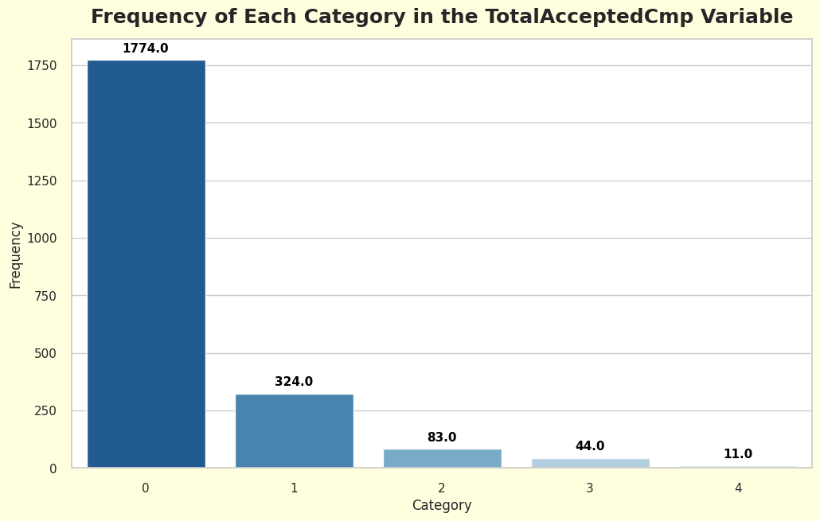
“PROMOTIONS”
Promotion: - For the Promotion , let’s group all the columns into “TotalAcceptedCmp” to understand better how many customers are choosing the offer.
(NumDealsPurchases,AcceptedCmp1,AcceptedCmp2,AcceptedCmp3,AcceptedCmp4,,AcceptedCmp5,Response)->” TotalAcceptedCmp”

Slide 12
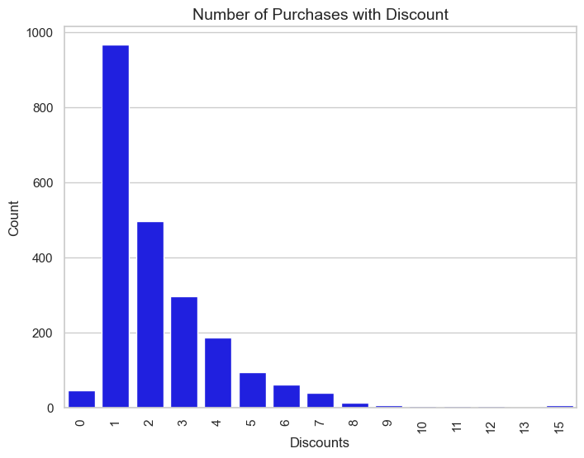
“PLACE”
Place: - For the Place feature group all 4 columns into “Num Web Purchases” to get a brief idea about where the customer is purchasing products mostly.
(NumWebPurchases,NumCatalogPurchases,NumStorePurchases,NumWebVisitsMonth)->“NumWebPurchases”

Slide 13
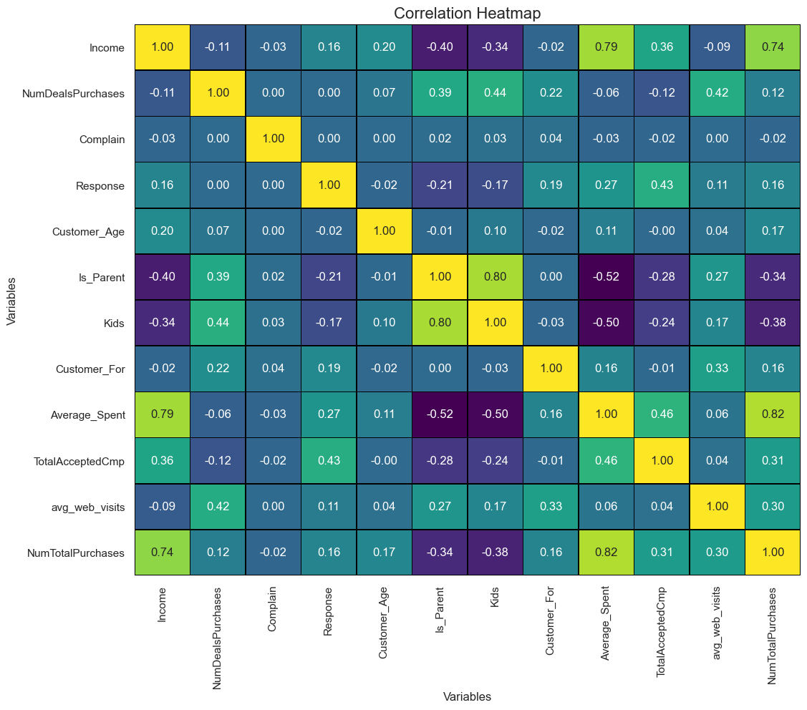
HEAT MAP

Slide 14
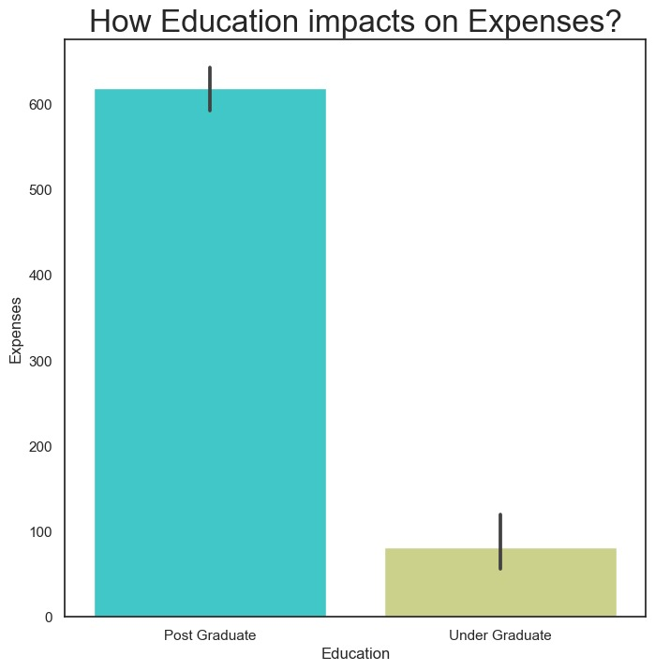
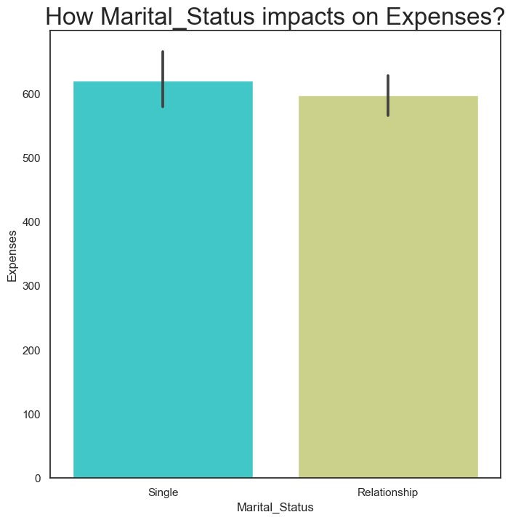
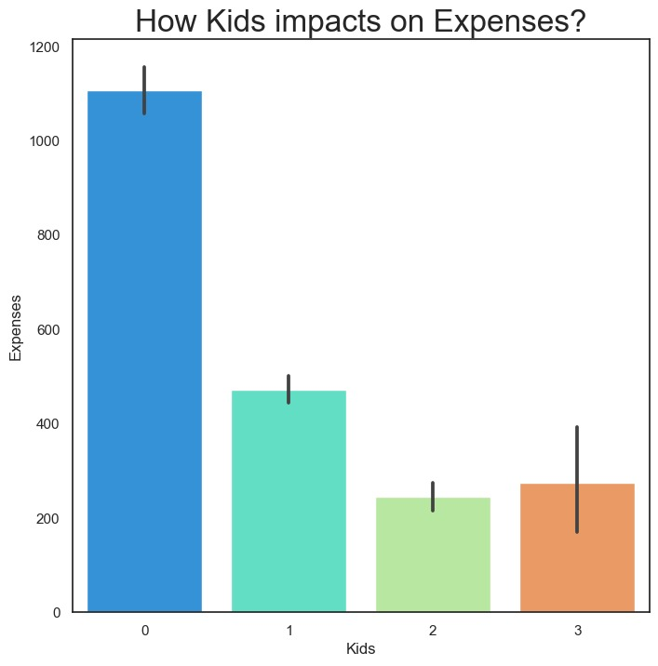
BIVARIATE ANALYSIS
Education vs Expenses: Marital status vs Expenses: Kids vs Expenses :

Slide 15
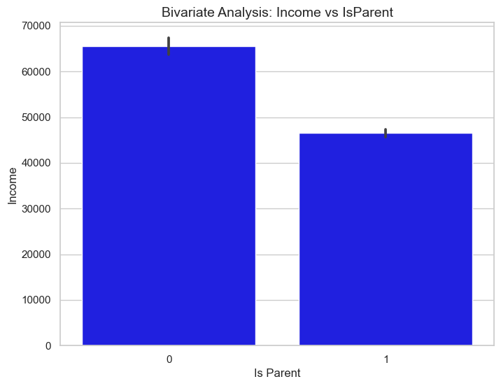
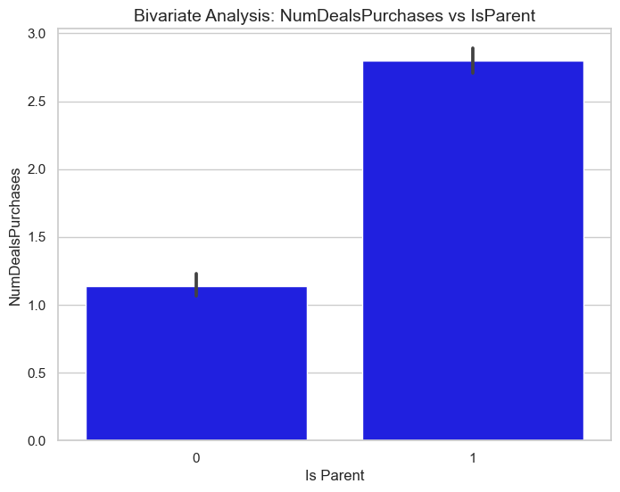
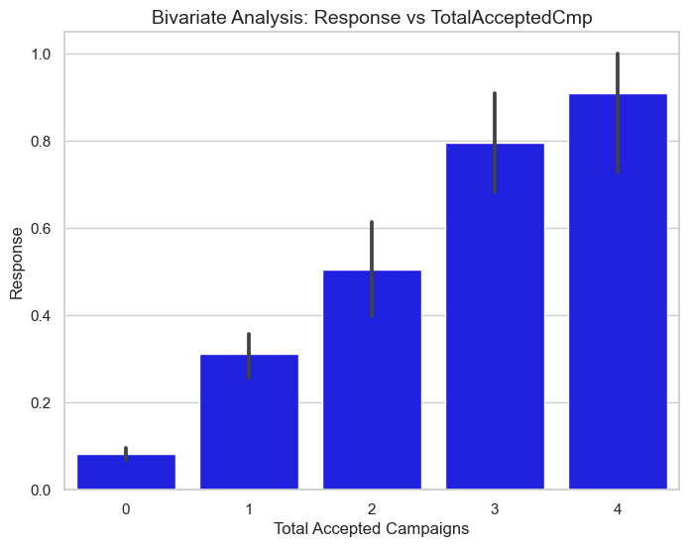
BIVARIATE ANALYSIS – (BAR PLOT)
Income VS Is _ Parent NumDealsPurchases vs Is_Parent Response vs TotalAcceptedCmp

Slide 16
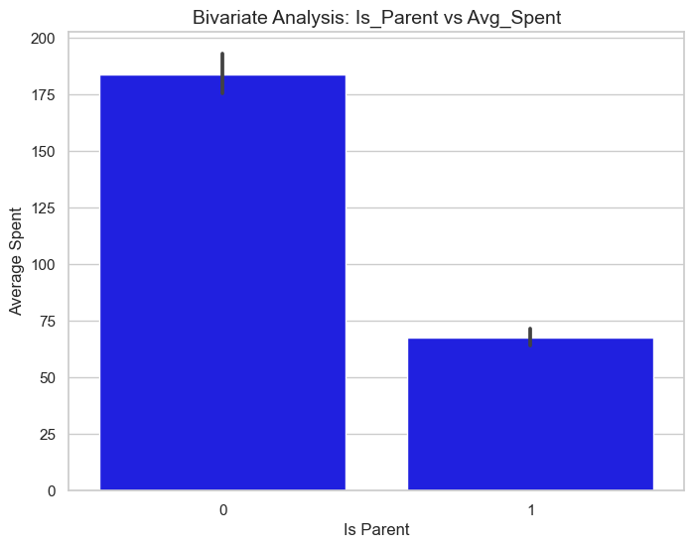
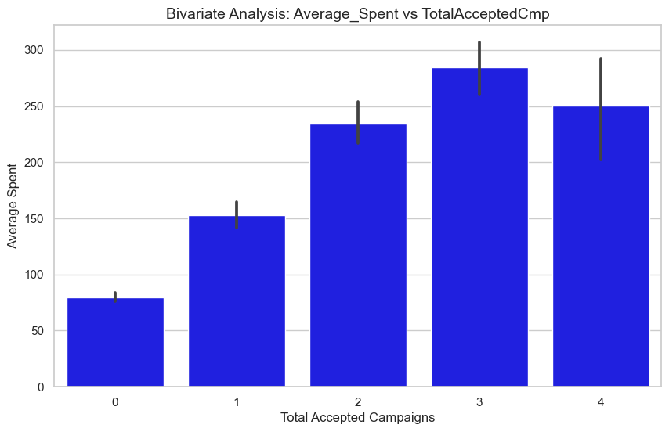
BAR PLOT
Is_Parent vs Average_Spent Average_Spent vs TotalAcceptedCmp

Slide 17
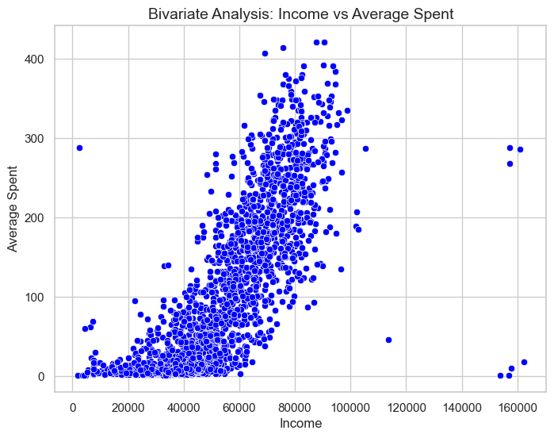
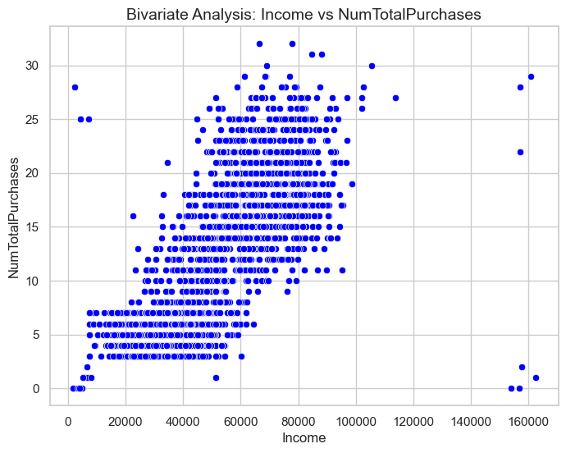
SCATTERPLOT
Income VS Average_Spent Income VS NumTotalPurchases

Slide 18
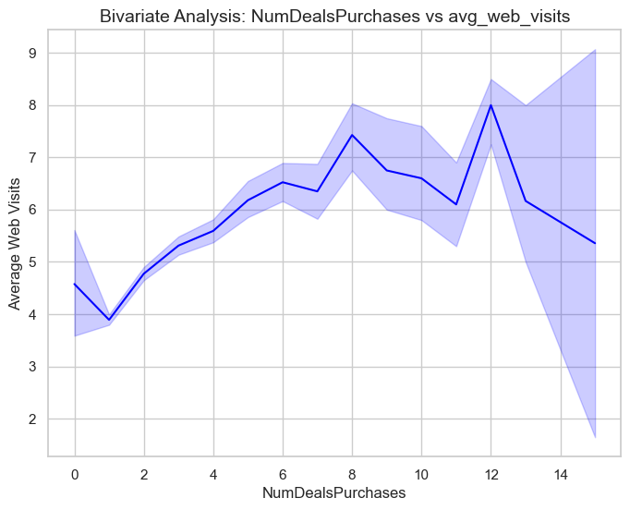
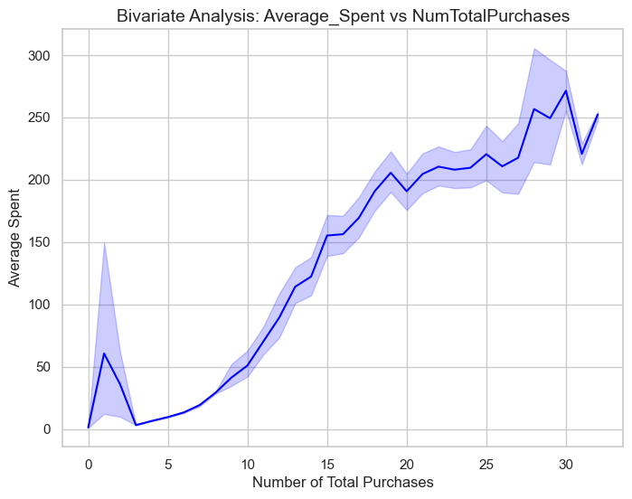
LINEPLOT
NumDealsPurchases vs avg_web_visits Average_Spent vs NumTotalPurchases

Slide 19
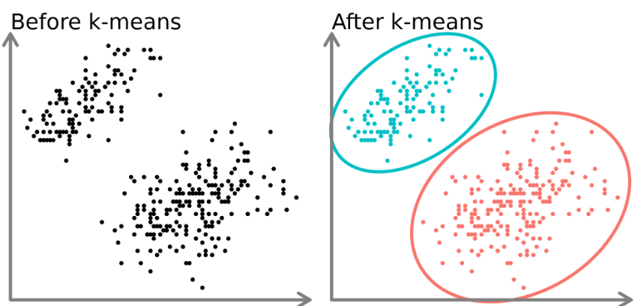
K-Means
K-Means the most commonly used clustering algorithm , it’s a “Centroid-based” algorithm and the simplest unsupervised learning algorithm.
This algorithm tries to minimize the “ Variance of data points within a cluster”

Slide 20
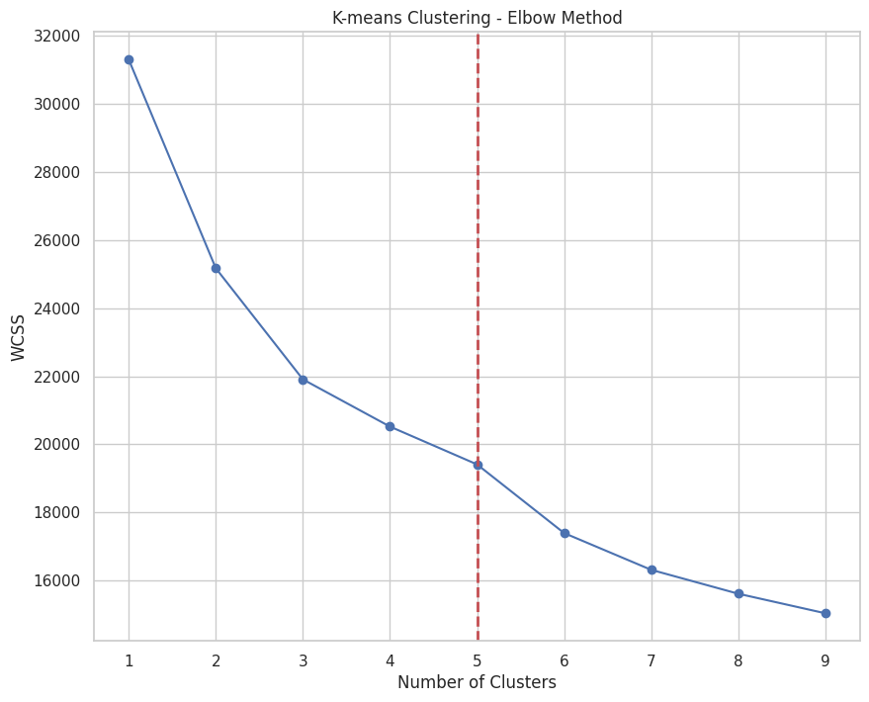
K-Means
ELBOW CURVE
The "elbow curve" refers to a graphical representation used in data analysis, specifically in the context of determining the appropriate number of clusters in a clustering algorithm.
From, this elbow curve we decided to take no of clusters as “5”

Slide 21
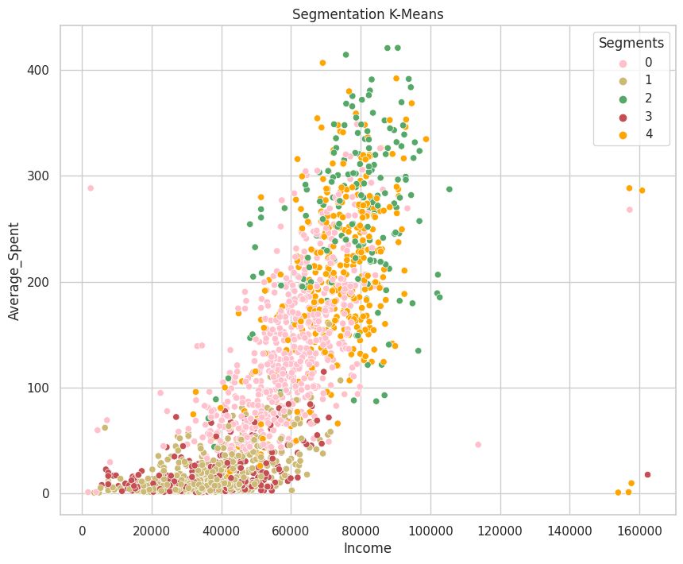
Based on our analysis on k-means, we drew a graph between income and average spent, and we decided to name the clusters as well-off and fewer-opportunities.

Slide 22
Silhouette Score
The Silhouette score is a matric used to evaluate the quality of clustering in data analysis and machine learning.
It measures how well instances with in a cluster are separated from instances with in a cluster are well separated from instances in other clusters.
“ The Score ranges from +1 to -1”.
silhouette score for ‘3’ and ‘5’ is same so we took “5”, i.e. (0.5150146938690833)

Slide 23
Training and Testing the Model accuracy
Split data into X and Y variable
→ X = data.drop("Cluster_id", axis=1)
→ y = data.Cluster_id
→ X.shape, y.shape
→ from sklearn.model_selection import train_test_split
x_train, x_cv, y_train, y_cv = train_test_split(X,y, test_size = 0.2, KNN_state = 10)
Import Classifier
→ from sklearn.ensemble import k nearest neighbor
→ model = k nearest neighborClassifier(max_depth=4, KNN _state = 10)
→ model.fit(x_train, y_train)
Saving the model
→ import pickle
→ pickle_out = open("classifier.pkl", mode = "wb")
→ pickle.dump(model, pickle_out)
→ pickle_out.close()

Slide 24
Clusters Conclusion
Cluster 0:
It has 2nd largest number of clusters and highest average spent customers.
Both high and mid educated people.
Mostly one kid and married customers.
Highest average web visits.
Has not accepted campaigns.
Cluster 1:
Large number of customers among all clusters.
High educated people
Mostly married customers and one kid
Highest complain compared to all clusters.
Least income and average spent customers
Has not accepted campaigns

Slide 25
Clusters Conclusion
Cluster 2:
Least number of clusters and least number of educated people.
No parents and no kids.
Has least complaints
Has highest response, income and average spent customers
Accepted more number of campaigns.
Cluster 3:
Mostly mid and low educated people,married customers and one kid
Least income and least average spent customers
Has more number of parent customers.
Medium number of purchases

Slide 26
Clusters Conclusion
Cluster 4:
Has both high and mid educated people
has no parents and no kids
has least response
has highest average spent customers
accepted less number of campaigns.

Slide 27
Model Deployment Using Streamlit
Model Building
Creating a python script
Create front-end: Python
Deploy

Slide 28
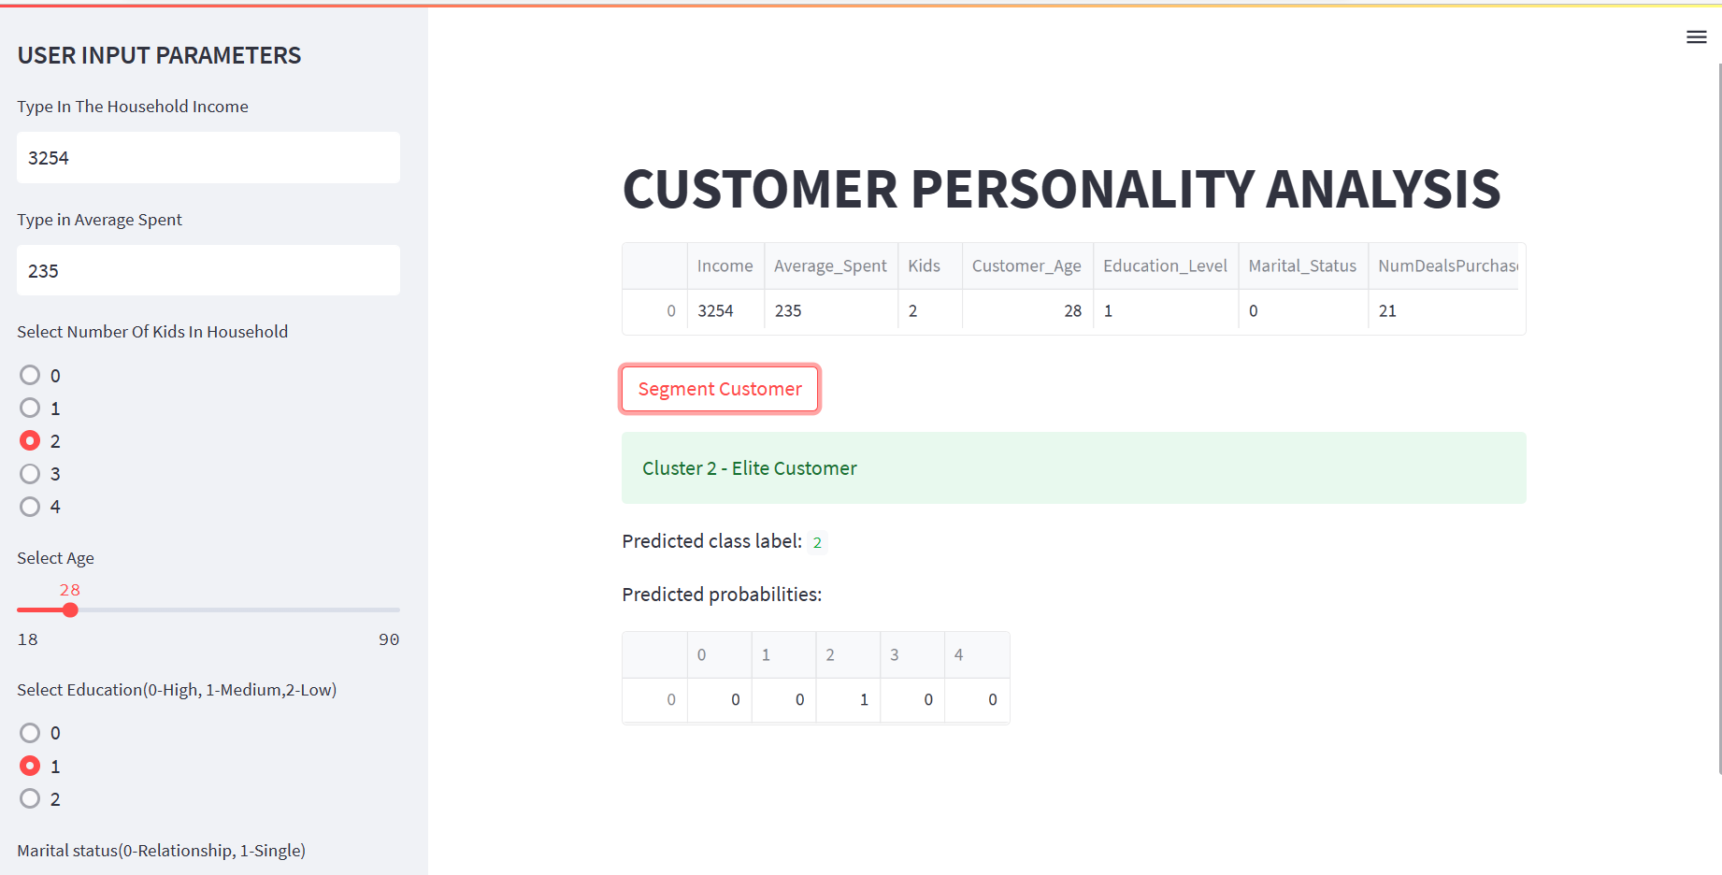
Deployment
Example:-1

Slide 29
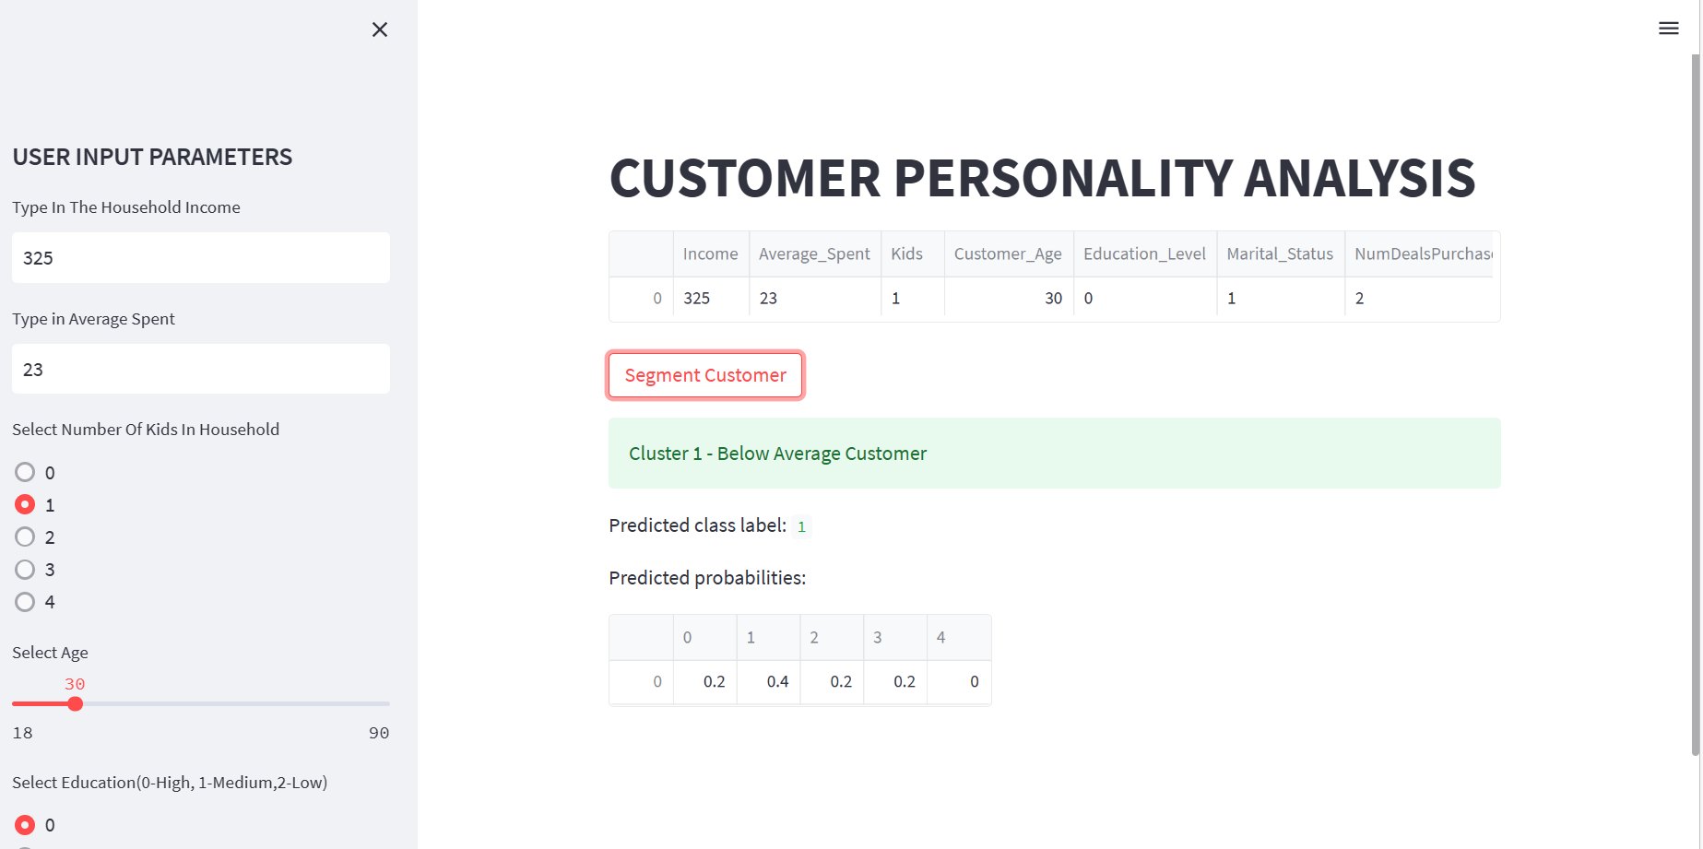
Deployment
Example:-2

Slide 30
Thank y☺u
☺

